Slide 1
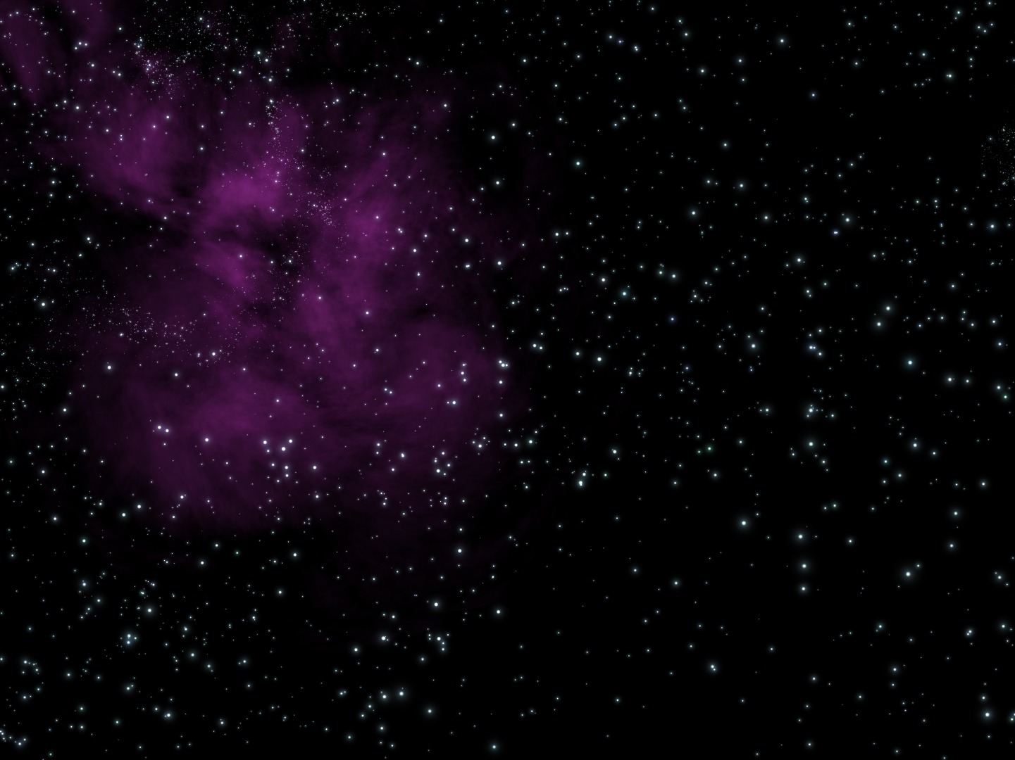

By:
Joseph Myers

Slide 2
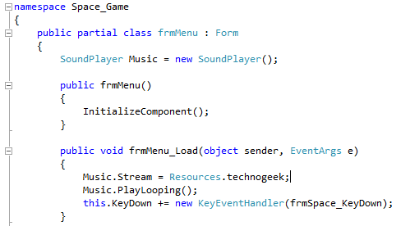
Discipline
Programming

Slide 3
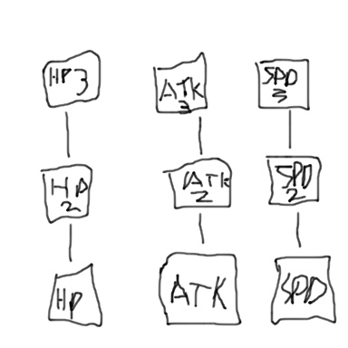
Creative Overiew
Space Exploration
Retake planets
Bosses
Final space boss
Gameplay: SHMUP (shoot 'em up)
space combat
Top down beat 'em up
Plot: Last human alive.
Sets out to take back 7 planets

Slide 4
Technical Overview
RPG leveling system
Space combat/movement
Planet combat/movement
Multiple classes/forms
Universal values

Slide 5
Personal Development Overview
Use of new code
Use of multiple forms and classes
Use of universal values

Slide 6
Project Timeline
Week 1
Gather Assets
Week 2
Ready assets for use
Week 3
Begin coding main menu
Week 4
Finish main menu, begin intro sequence/selections
Week 5
Finish intro sequence/selections, begin space exploration segment
Week 6
Start first planet, continue space segment
TERM BREAK Week 1
Start second planet, continue space segment
TERM BREAK WEEK 1
Start third planet, continue space segment

Slide 7
Project Timeline
Week 7
Start fourth planet, continue space segment
Week 8
Start fifth planet, continue space segment
Week 9
Start sixth planet, continue space segment
Week 10
Start seventh planet, continue space segment
Week 11
Start eighth planet, continue space segment
Week 12
Finalise planets, finalise space segment (final boss)
Week 13
Finalise upgrade system, final sequence
Week 14
Finalise entire program, optimise

